Slide 1
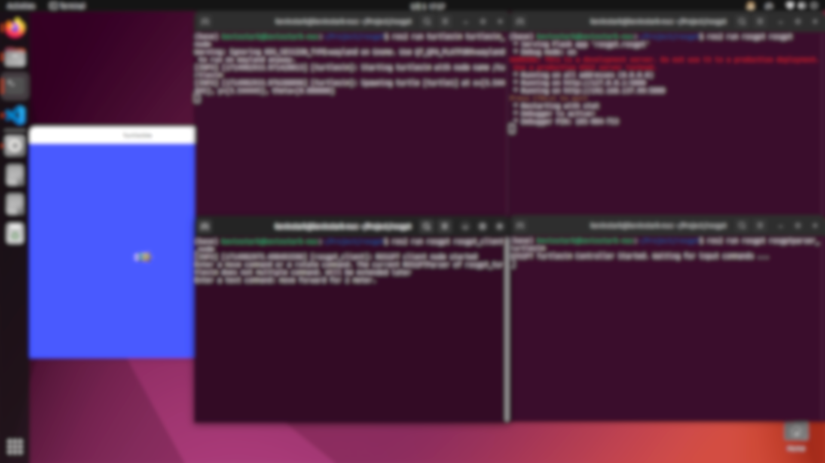
Use LLM to understand user input and control the robot under ROS
Kevin Stark 高梦扬
202164010233

Slide 2
Introduction
Traditional robot operation interfaces
Professional programming knowledge and skills
a human-robot interaction system that controls robot movement using a large language model (LLM) within the Robot Operating System (ROS)
Simplifying human-robot interaction, or say Human-Computer-Interaction(HCI)

Slide 3
Introduction
Connect the planning group required for control
2. Set the target pose (joint space or Cartesian space)
3. set motion constraints and path constraints
4. Use motion solvers and planners (such as the Moveit framework) to plan a feasible motion path
5. Execute

Slide 4
Introduction
0. The task
Connect the planning group required for control
2. Set the target pose (joint space or Cartesian space)
3. set motion constraints and path constraints
4. Use motion solvers and planners (such as the Moveit framework) to plan a feasible motion path
5. Execute

Slide 5
Toolbox and Software
System: Ubuntu 22.04
ROS: ROS 2 Humble
LLM:
A: Commercial LLM, like ChatGPT
B: Open-Source LLM, like Llama3 (optional)
Use Ollama to bulid a Local LLM environment, use LiteLLM to provide API.

Slide 6
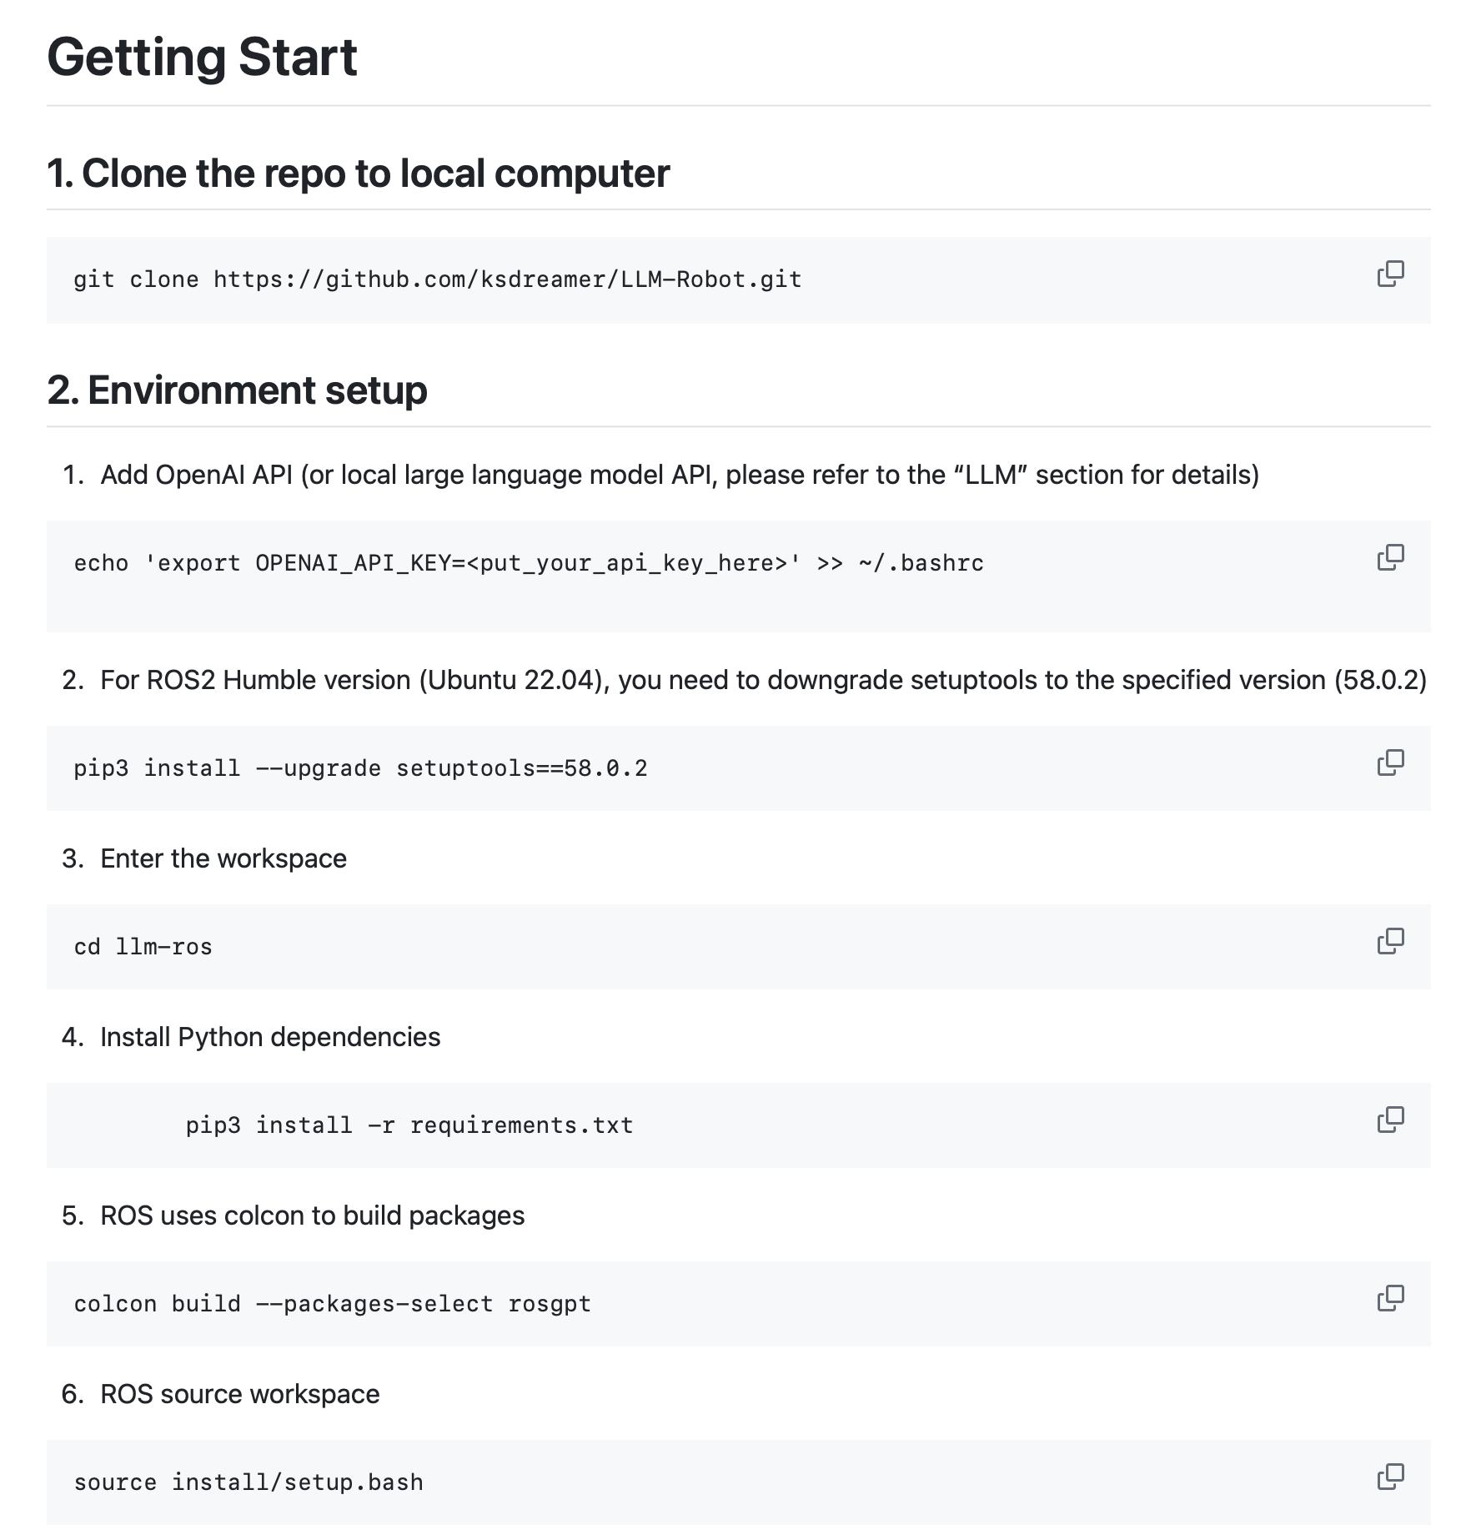
Getting Start
See https://github.com/ksDreamer/LLM-Robot

Slide 7
Formulation
The core logic of the system is divided into the following steps:
1. Users send control commands to the system through natural language (voice or text).
2. The system parses the command using a LLM with customized knowledge and converts it into ROS control code.
3. In ROS, each node executes the code to control the robot to perform corresponding actions.

Slide 8
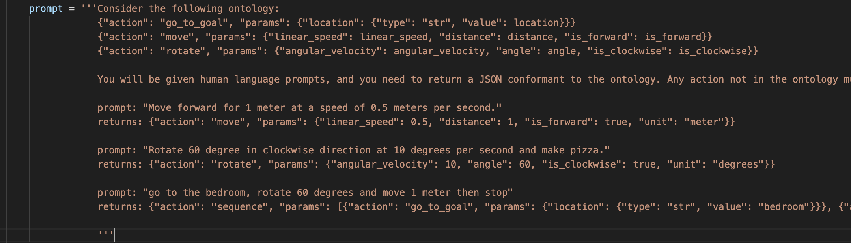
Methods-LLM
The most important idea of this project is to use large language models such as ChatGPT-3.5 or Llama3. From the chatgpt_ros2_node node, according to certain requirements (Prompt, returning JSON format), convert user input, and then input it to the turtlesim_controller node.

Slide 9

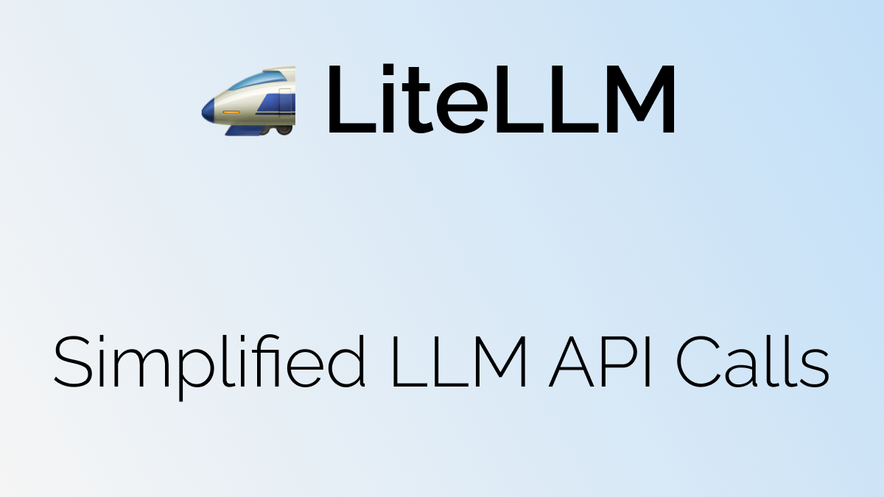
Methods-Local LLM
Use Llama.cpp, Ollama, or LMStudio to depoly Local Open-Source LLM
Use LiteLLM to generate the API of local LLM

Slide 10
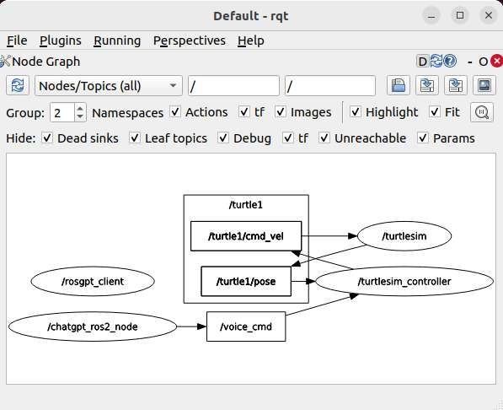
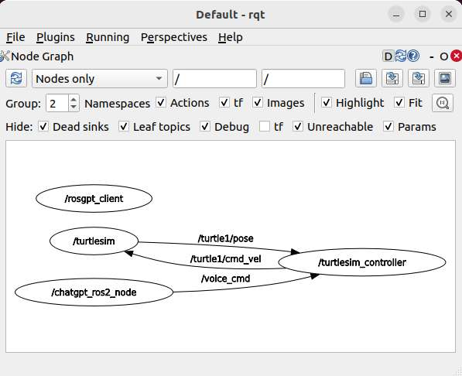
Methods-ROS-rqt graph

Slide 11
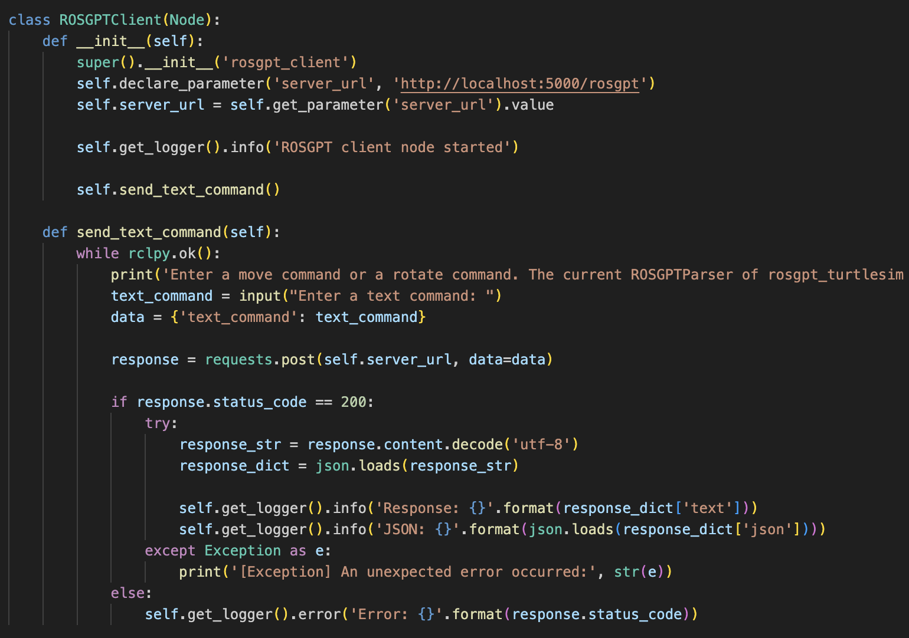
Methods-ROS-rosgpt_client
Define a node rosgpt_client，it receives 'server_url'，and has a function 'send_text_command'
function'send_text_command' ask user to enter a command, then read it and send to ROSGPT service.

Slide 12
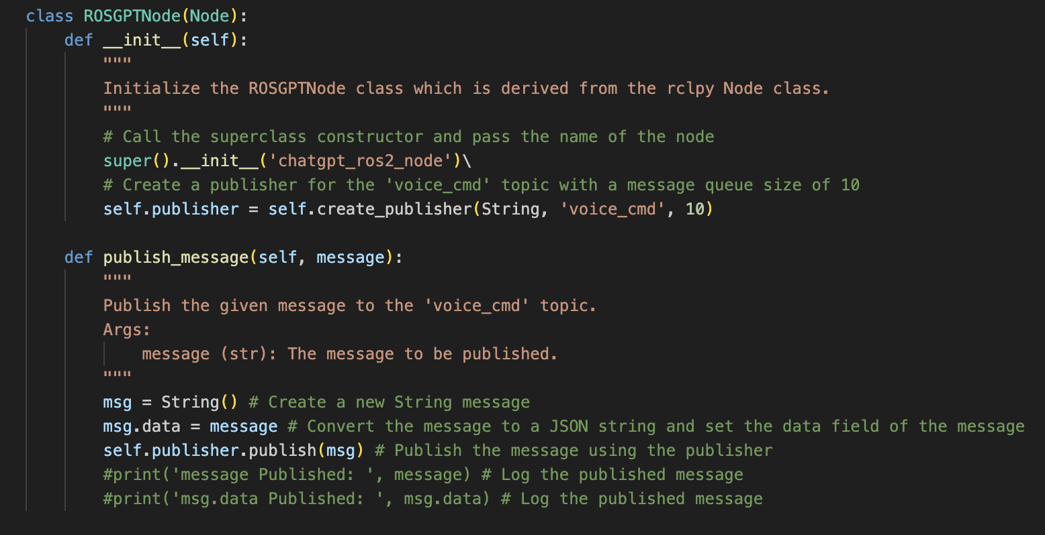
Methods-ROS-chatgpt_ros2_node
Define chatgpt_ros2_node，create a publisher，publish commands by topic 'voice_cmd' in JSON format.

Slide 13
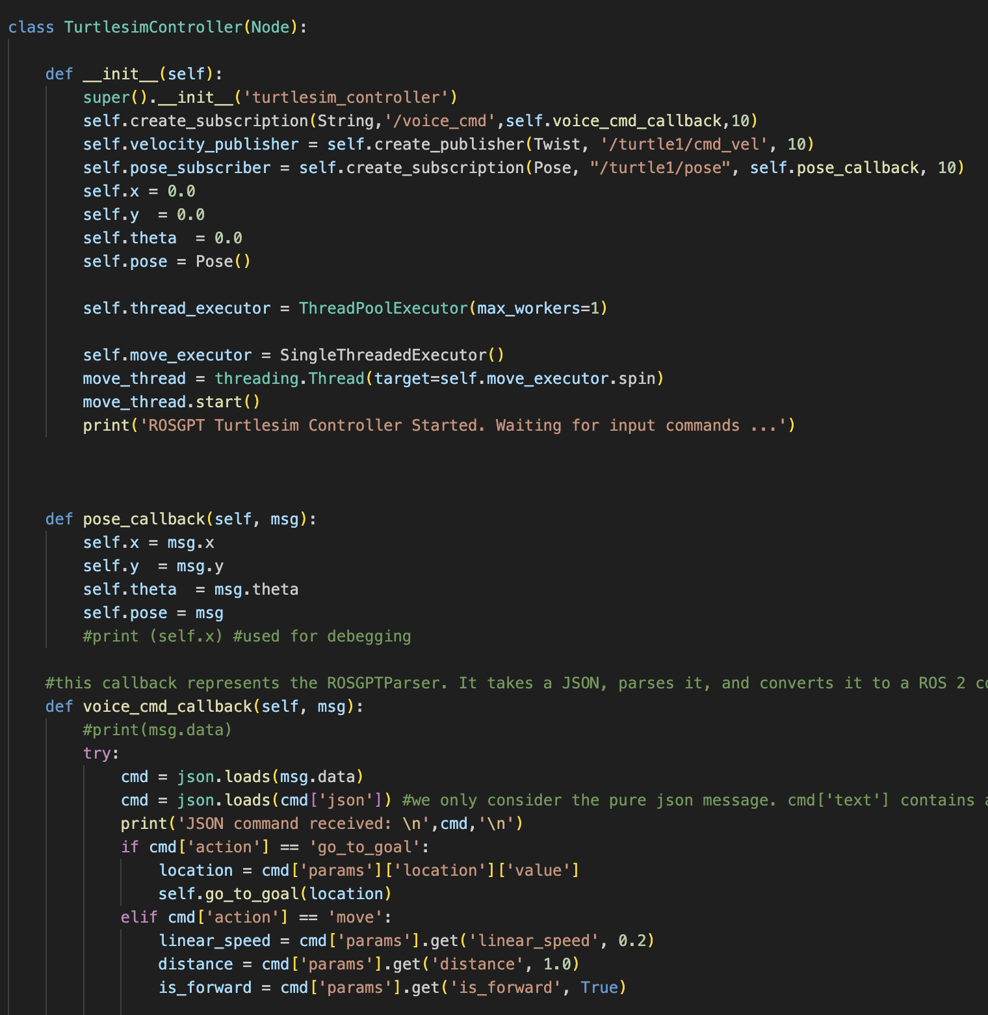
Methods-ROS-turtlesim_controller
Use to control the ROS turtlesim simulator.
Receives commands from the /voice_cmd topic, parse these commands, and publish the parsed commands to the /turtle1/cmd_vel topic to control the movement of the turtlesim simulator.
At the same time, it also subscribes to the /turtle1/pose topic to obtain the current position and orientation information of the turtlesim simulator.

Slide 14
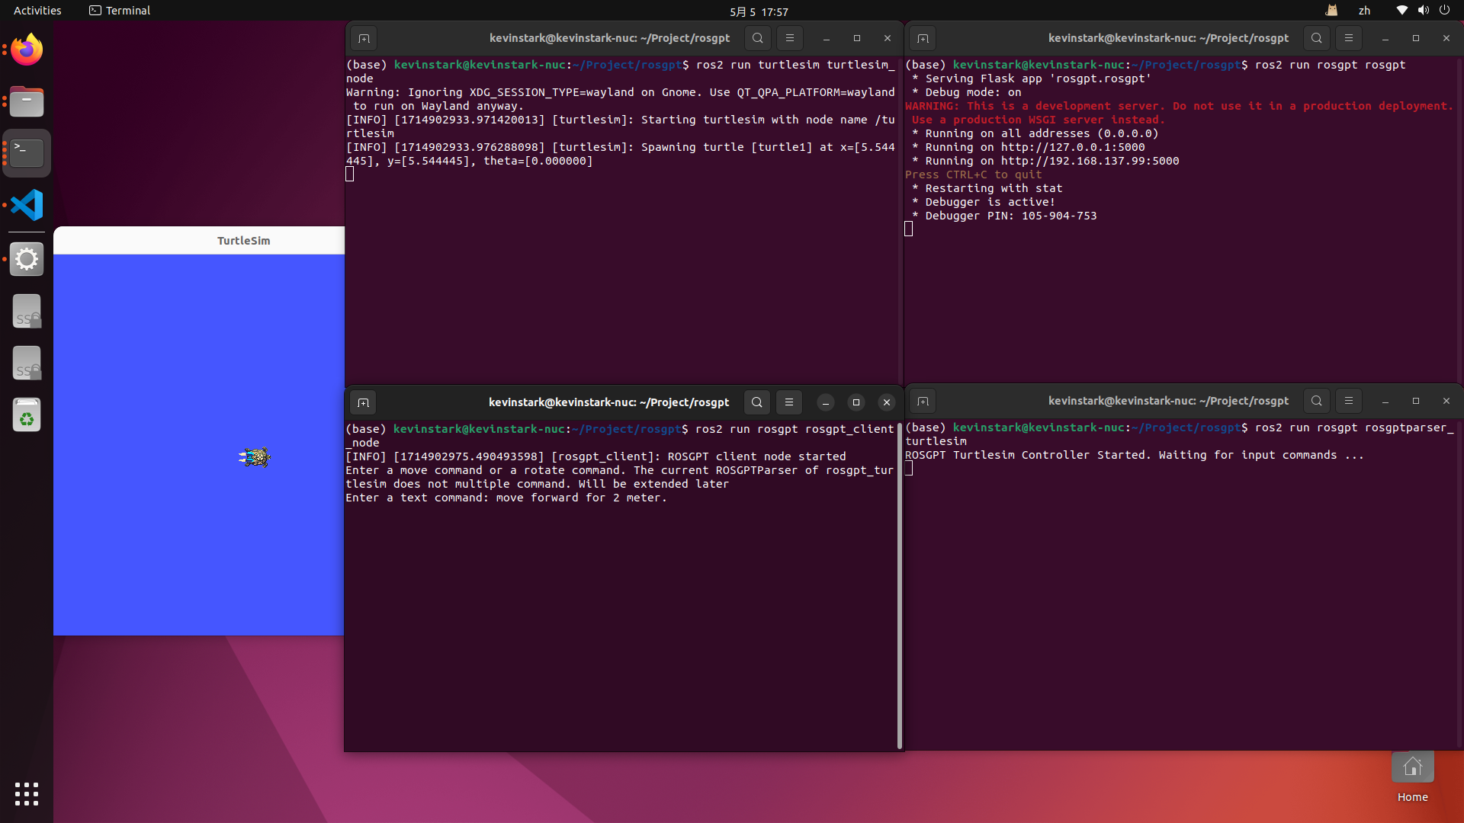
Result and Disscusion
we send a message in terminal, asking it to move forward for 1 meter.
The turtle simulator run as we want.

Slide 15
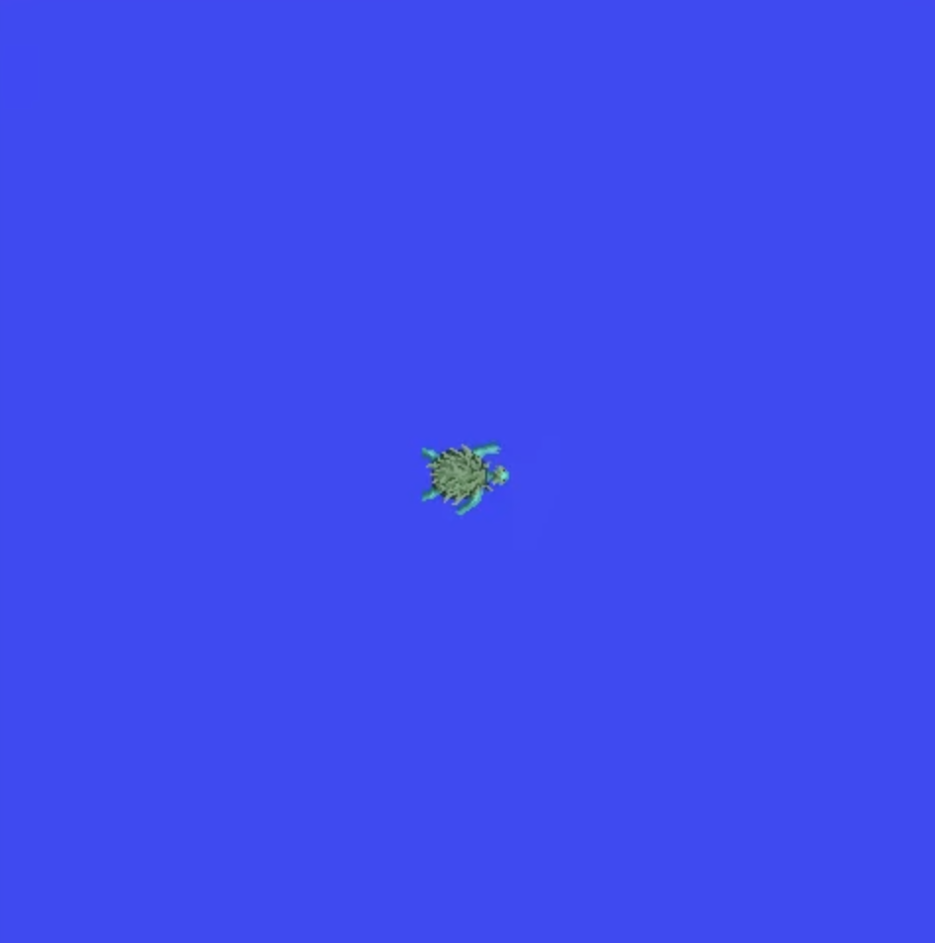
I want that you move 1 meter forward speed 0.2
{“action”: “move”, “params”:{”linear_speed”: 0.2, “distance”: 1. “is_forward”: true. “unit”: “meter”

Slide 16
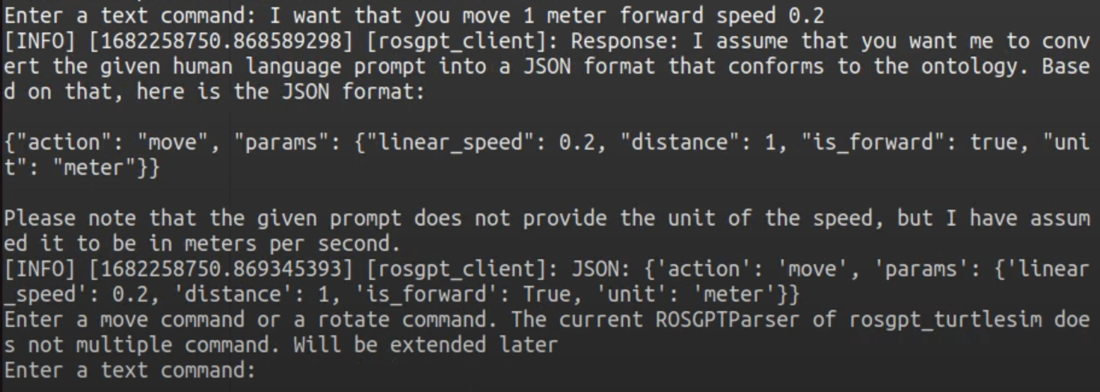
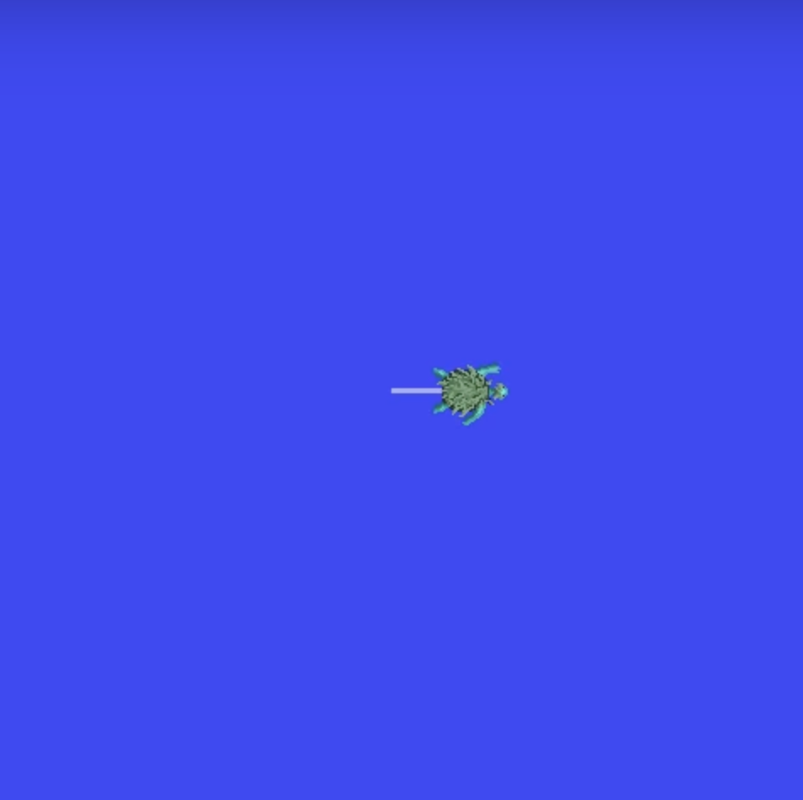
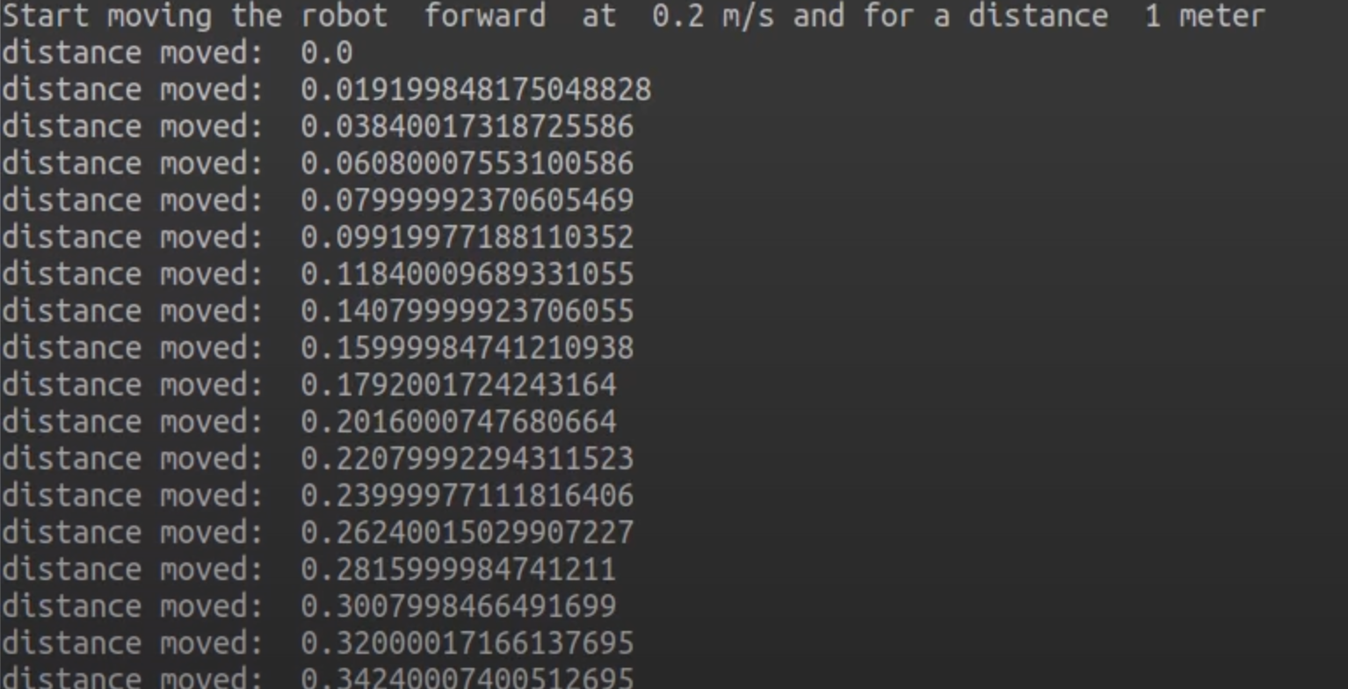

Slide 17
Conclusion
We integrates a large language model (LLM) with the Robot Operating System (ROS) to control the movement of robots.
Pros
Cons
Reduced Operational Threshold
Enhanced User Experience
Improved Robot's Ability to Execute Complex Tasks and Application Range
Technical Complexity
Performance and Reliability
Safety

Slide 18
Future Work
vision language model and sensing ability
moveit 2 framework and robot arm
robot simulation like gazebo and webots, NVIDIA's Omniverse and Isaac Sim

Slide 19
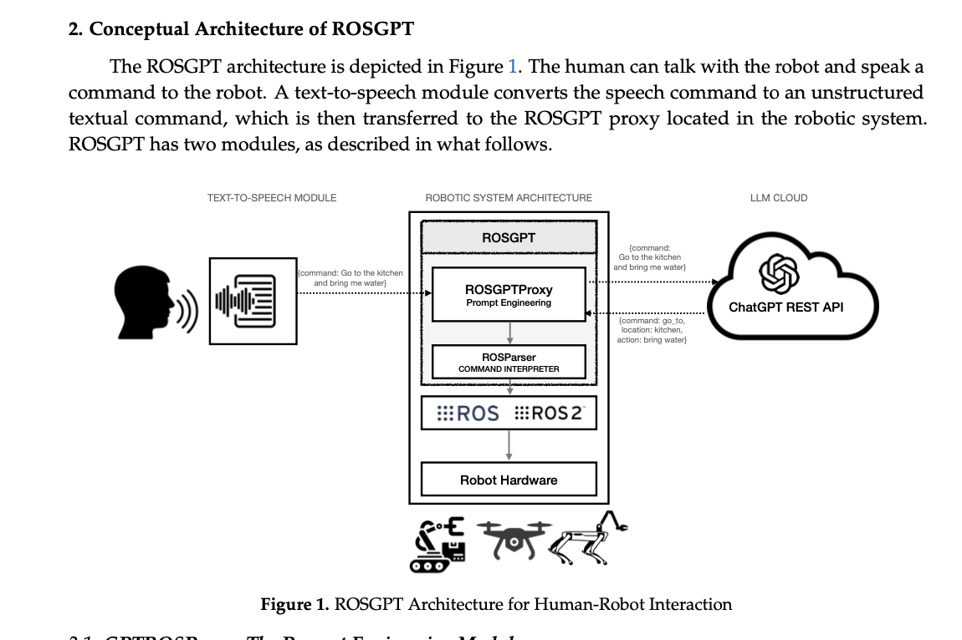
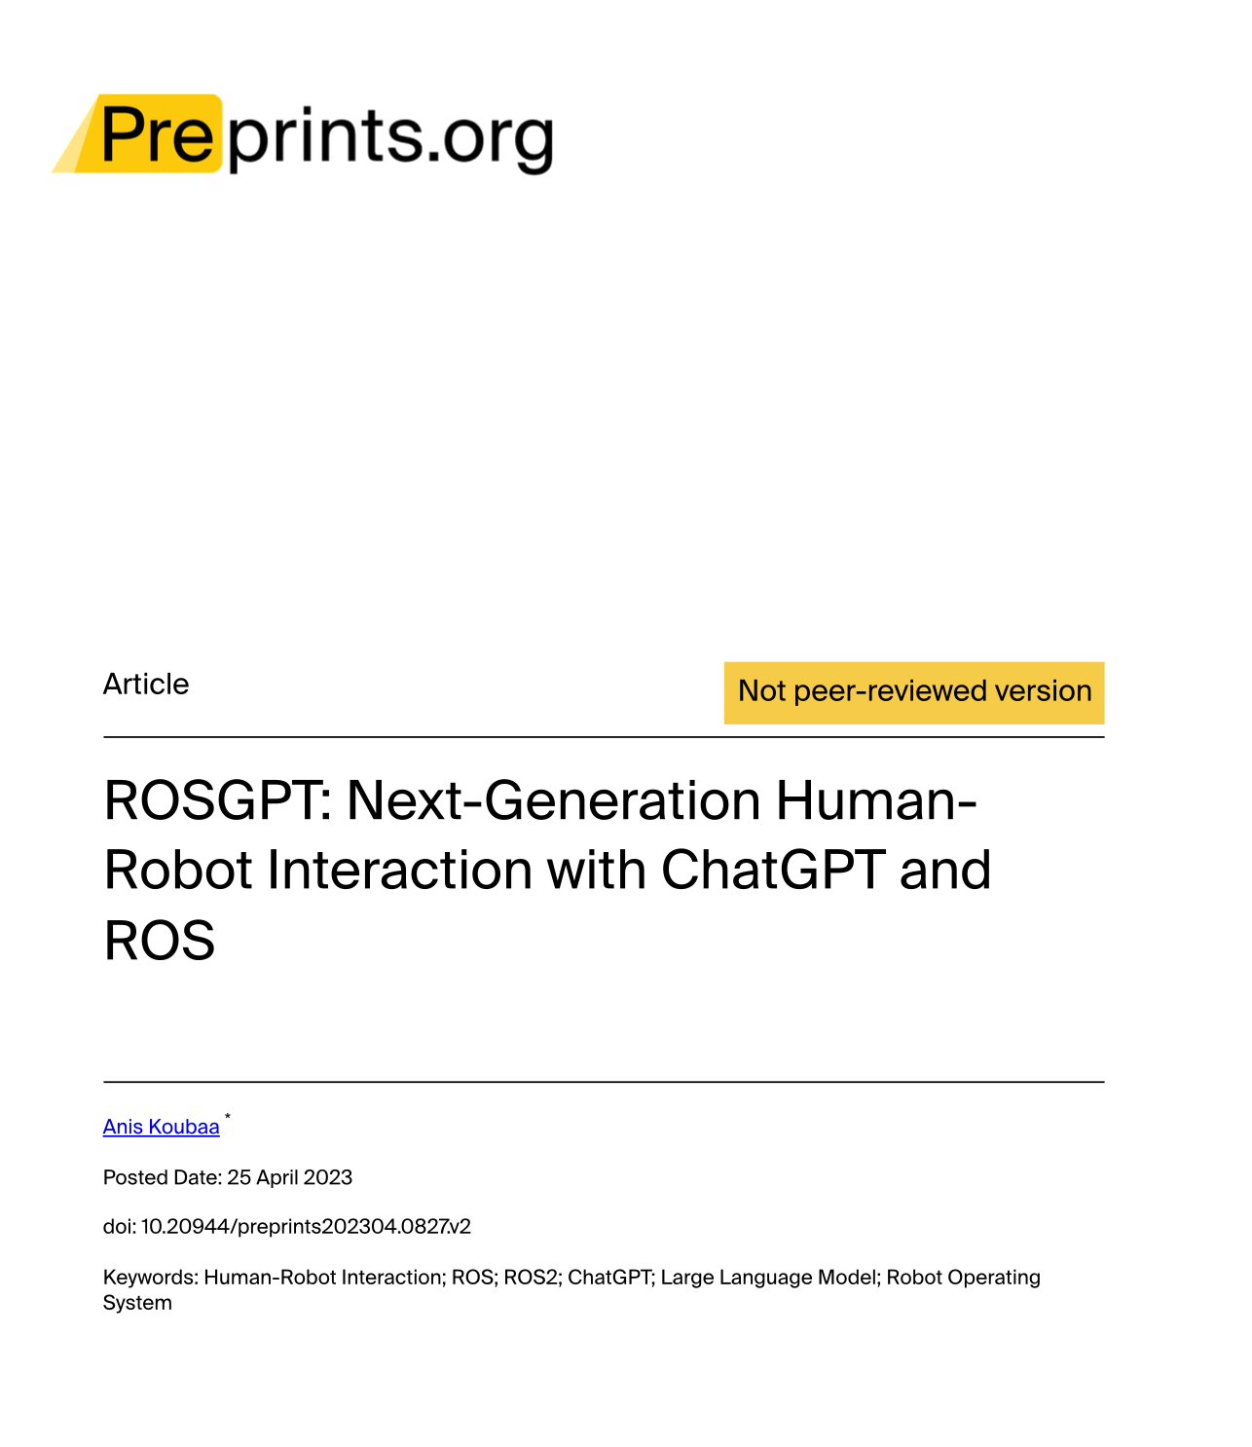
Reference and Acknowledgement
In our project, we implemented a human-robot interaction system based on the ROSGPT package, developed by Anis Koubaa (2023). ROSGPT integrates the ChatGPT language model with the Robot Operating System (ROS) to enable natural language understanding and generation for robotic tasks. The project is available on github, ROSGPT: ChatGPT Interface for ROS2 for Human-Robot Interaction,
Koubaa, A. (2023). ROSGPT: Next-Generation Human-Robot Interaction with ChatGPT and ROS. Preprints.org, 2023, 2023040827. https://www.preprints.org/manuscript/202304.0827/v2.

Slide 20
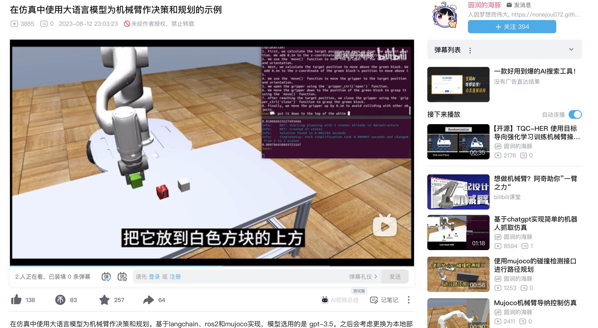
Reference and Acknowledgement
ROS 2 Documentation: Humble
Ollama
Litellm
https://deepmind.google/discover/blog/rt-2-new-model-translates-vision-and-language-into-action/
https://github.com/NoneJou072/robochain
https://github.com/Auromix/ROS-LLM
https://github.com/microsoft/PromptCraft-Robotics
https://github.com/AndrejOrsula/drl_grasping
https://github.com/GT-RIPL/Awesome-LLM-Robotics
Python import openai library ImportError
鱼香 ROS
古月居·ROS2入门21讲

